Slide 1
College level Quiz CONTEST
By DHL
31ST DECEMBER 2023

Slide 2
Which dynasty ruled China from 1368 to 1644?
Hindi: किस वंश ने 1368 से 1644 तक चीन को शासित किया? a) tang b ) hang c) Ming d ) quing

Slide 3
Ming

Slide 4

03
04
Enter a headline
02
Click here to add content of the text，Click here to add content of the text，
Enter a headline
Enter a headline
Click here to add content of the text，Click here to add content of the text，
Click here to add content of the text，Click here to add content of the text，
e
Who wrote "The Prince" during the Renaissance?
Hindi: नैतिकता के दौरान "द प्रिंस" किसने लिखा था?
A) nicolo Machiavelli
B) Adam green
Cjhon Green
D) Fred Green

Slide 5
Nicolo Machiavelli

Slide 6



01
Enter a headline
FOR STUDENTS
In which ancient civilization did Hammurabi establish a legal code?
Hindi: हम्मुराबी किस प्राचीन सभ्यता में एक कानूनी संहिता स्थापित करते थे?
Indian , Roman , Babylonian, Harappan

Slide 7
Babylonian

Slide 8
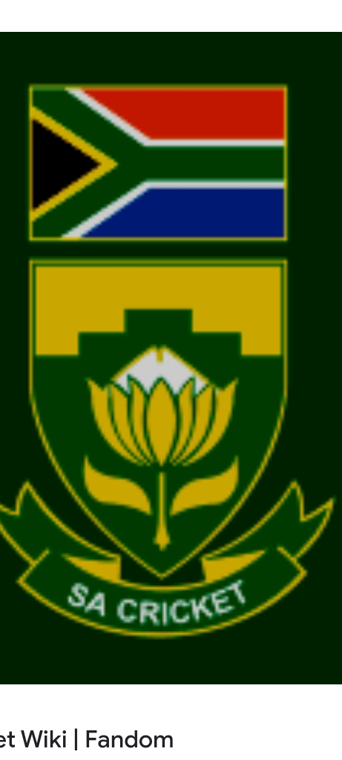
Please enter your title
Click here to add content of the text，Click here to add content of the text，Click here to add text content ，Click here to add content of the text，Click here to add content of the text，Click here to add text content ，
Please enter your title
Click here to add content of the text，Click here to add content of the text，Click here to add text content ，Click here to add content of the text，Click here to add content of the text，Click here to add text content ，
What is the capital of South Africa?
Hindi: दक्षिण अफ्रीका की राजधानी क्या है?

Slide 9
Pretoria

Slide 10
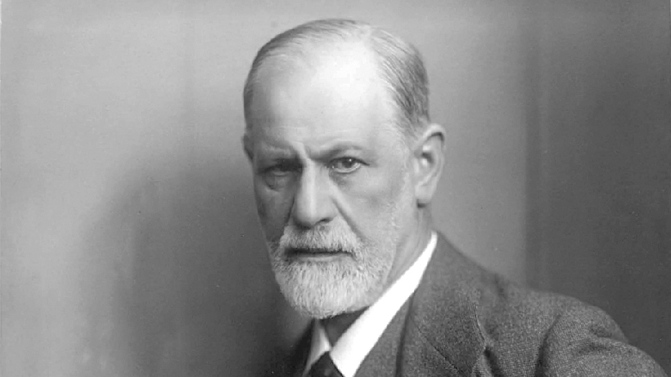
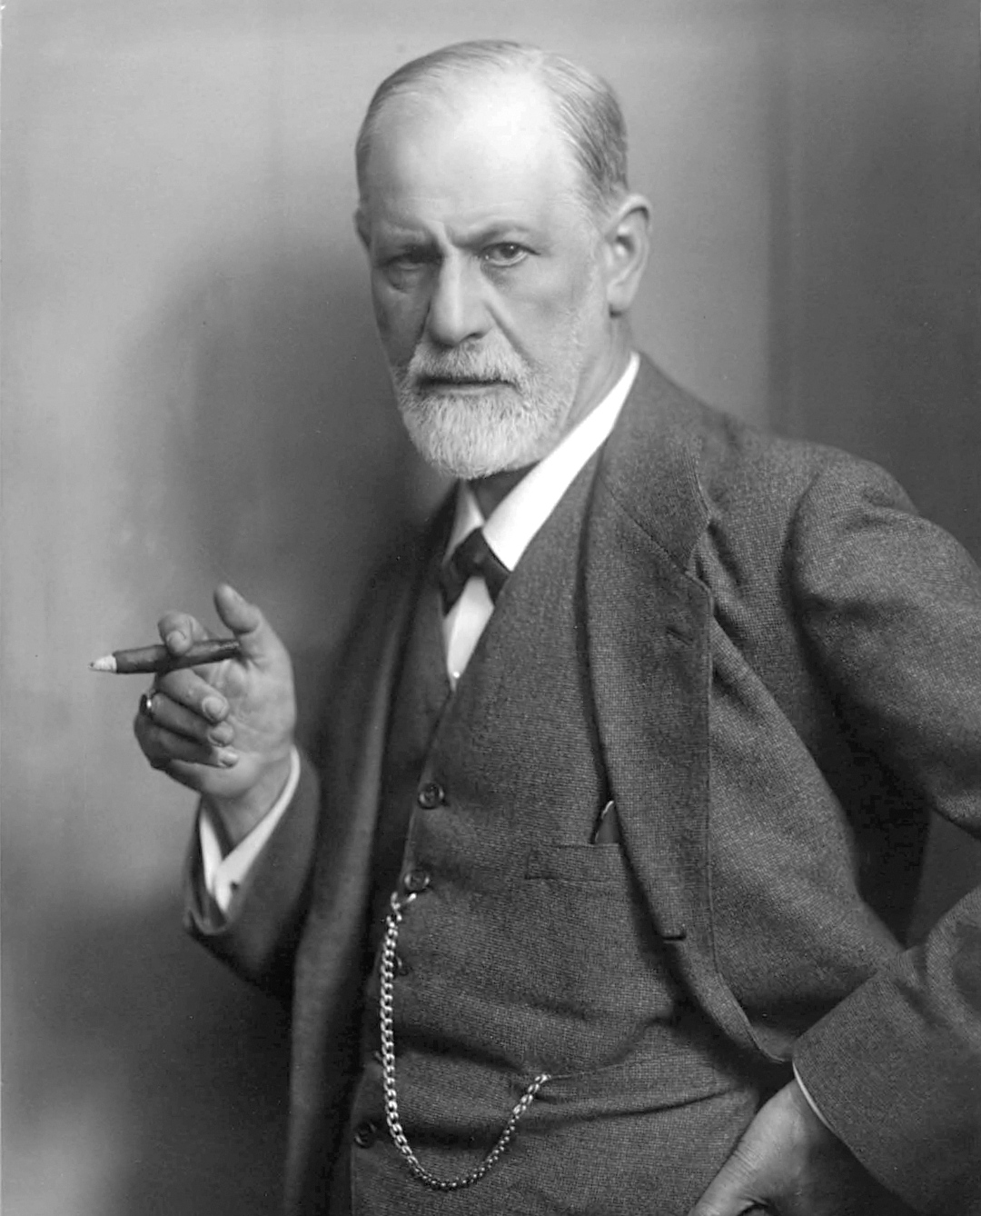
Please enter your title
Click here to add content of the text，Click here to add text content ，Click here to add text content
Please enter your title
Click here to add content of the text，Click here to add text content ，Click here to add text content
Please enter your title
Click here to add content of the text，Click here to add text content ，Click here to add text content
Who formulated the theory of psychoanalysis?Hindi: मनोविज्ञान के सिद्धांत को कौन रचा?
a) B.F. Skinner
b) Sigmund Freud
c) Ivan Pavlov
d) John Watson

Slide 11
Sigmund Freud

Slide 12
How many Shastras are there in Indian music?
Hindi Translation: भारतीय संगीत में कितने शास्त्र हैं?
a) 2
b) 3
c) 4
d) 5

Slide 13
Please enter your title
Please enter your title
Click here to add content of the text，Click here to add content of the text，Click here to add text content ， Click here to add text content ，
Click here to add content of the text，Click here to add content of the text，Click here to add text content ， Click here to add text content ，
Please enter your title
Please enter your title
Click here to add content of the text，Click here to add content of the text，Click here to add text content ， Click here to add text content ，
Click here to add content of the text，Click here to add content of the text，Click here to add text content ， Click here to add text content ，
Answer - 3

Slide 14
02
FOR STUDENTS
Enter a headline
How many literary eras are there in Indian literature?
Hindi Translation: भारतीय साहित्य के कितने काल हैं?
a) 4
b) 5
c) 6
d) 7

Slide 15
Enter title
Enter title
Click here to add content of the text，Click here to add content of the text，Click here to add text content ，
Click here to add content of the text，Click here to add content of the text，Click here to add text content ，
Enter title
Enter title
Enter title
Click here to add content of the text，Click here to add content of the text，Click here to add text content ，
Click here to add content of the text，Click here to add content of the text，Click here to add text content ，
Click here to add content of the text，Click here to add content of the text，Click here to add text content ，
Answer - 6

Slide 16

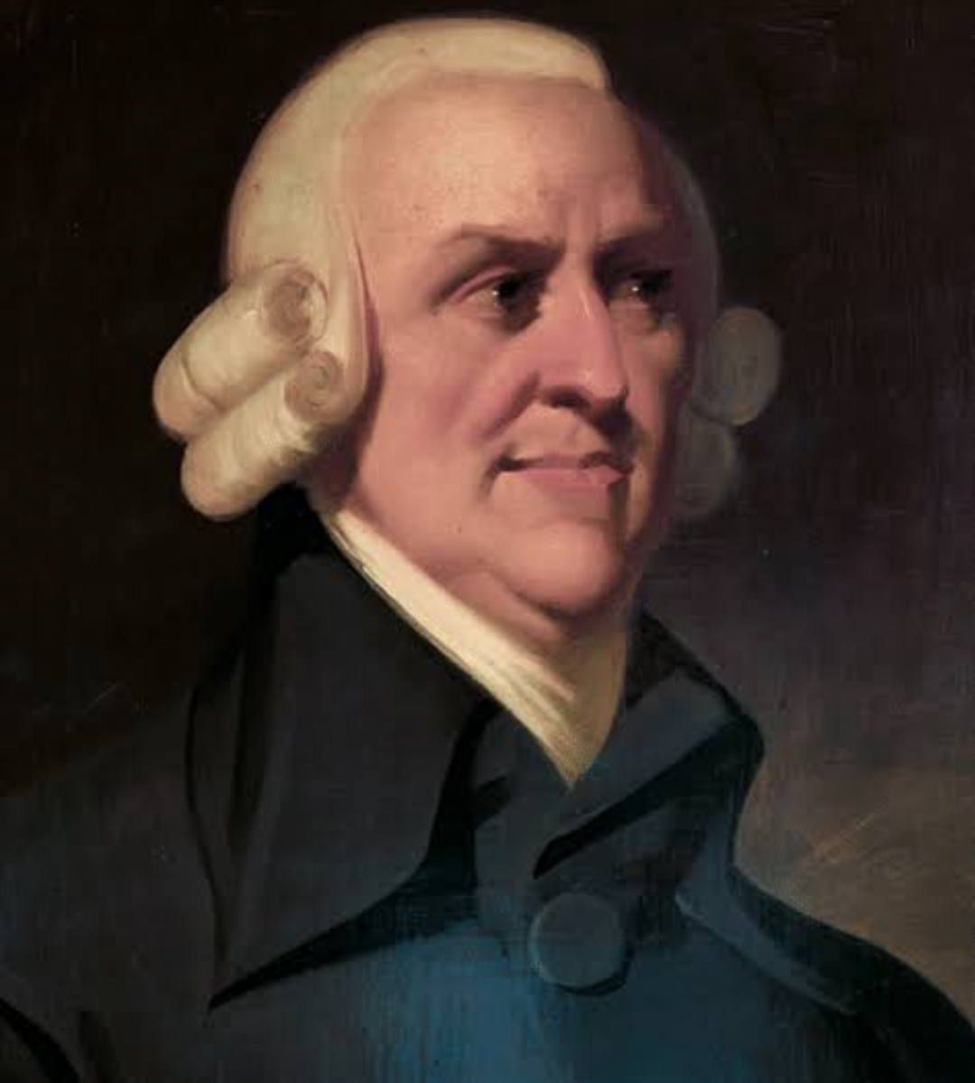
Enter title
Enter title
Click here to add content of the text，Click here to add content of the text，Click here to add text content ，
Click here to add content of the text，Click here to add content of the text，Click here to add text content ，
Enter title
Enter title
Click here to add content of the text，Click here to add content of the text，Click here to add text content ，
Click here to add content of the text，Click here to add content of the text，Click here to add text content ，
Who is known as the "Father of Economics"?
Hindi Translation: अर्थशास्त्र के 'पिता' किसे कहा जाता है?
a) John Maynard Keynes
b) Adam Smith
c) Karl Marx
d) Alfred Marshall

Slide 17
03
FOR STUDENTS
Enter a headline
Adam smith

Slide 18
Please enter your title
Please enter your title
Click here to add content of the text，Click here to add text content ，
Click here to add content of the text，Click here to add text content ，
Please enter your title
Please enter your title
Click here to add content of the text，Click here to add text content ，
Click here to add content of the text，Click here to add text content ，
Please enter your title
Please enter your title
Click here to add content of the text，Click here to add text content ，
Click here to add content of the text，Click here to add text content ，
Who wrote the book "The Social Contract"?
Hindi Translation: किसने पुस्तक "सामाजिक समझौता" लिखी थी?
a) John Locke
b) Jean-Jacques Rousseau
c) Thomas Hobbes
d) Montesquieu

Slide 19
Click here to add content of the text，Click here to add content of the text，Click here to add text content ，
Jean Jacques Rossuese

Slide 20
Enter title
Enter title
Enter title
Click here to add content of the text，Click here to add content of the text，Click here to add text content ，Click here to add content of the text，Click here to add content of the text，Click here to add text content ，Click here to add content of the text，Click here to add content of the text，Click here to add text content ，
Click here to add content of the text，Click here to add content of the text，Click here to add text content ，Click here to add content of the text，Click here to add content of the text，Click here to add text content ，Click here to add content of the text，Click here to add content of the text，Click here to add text content ，
Click here to add content of the text，Click here to add content of the text，Click here to add text content ，Click here to add content of the text，Click here to add content of the text，Click here to add text content ，Click here to add content of the text，Click here to add content of the text，Click here to add text content ，
Which river is known as the "Ganga of the South"?
Hindi Translation: कौन सी नदी "दक्षिण का गंगा" कहलाती है?
a) Godavari
b) Krishna
c) Cauvery
d) Yamuna

Slide 21
04
FOR STUDENTS
Enter a headline
Godavri

Slide 22
Enter title
Click here to add content of the text，Click here to add content of the text，Click here to add text content ，
Enter title
Enter title
Click here to add content of the text，Click here to add content of the text，Click here to add text content ，
Click here to add content of the text，Click here to add content of the text，Click here to add text content ，
Which treaty marked the end of the First World War?
Hindi Translation: पहले विश्व युद्ध का समापन किस संधि ने किया?
a) Treaty of Versailles
b) Treaty of Brest-Litovsk
c) Treaty of Trianon
d) Treaty of Sevres

Slide 23
FOR YOUR ATTENTION
THANK YOU
Treaty of Versailles

Slide 24
If a triangle has angles in the ratio 3:4:5, what type of triangle is it?
Hindi Translation: यदि एक त्रिभुज के कोणों का अनुपात 3:4:5 है, तो यह किस प्रकार का त्रिभुज है?
a) Equilateral
b) Right-angled
c) Isosceles
d) None of these

Slide 25
Right angled

Slide 26
Who is the current Secretary-General of the United Nations?
- Hindi Translation: संयुक्त राष्ट्र के वर्तमान महासचिव कौन है?
- a) Ban Ki-moon
- b) António Guterres
- c) Kofi Annan
- d) Ban Ki-moon

Slide 27
Antonio Guetteres

Slide 28
In which year was the Paris Agreement on climate change adopted?
Hindi Translation: पेरिस समझौते पर जलवायु परिवर्तन कब अधिसूचित किया गया था?
a) 2014
b) 2015
c) 2016
d) 2017

Slide 29
2015

Slide 30
Who is the current Chief Justice of the Supreme Court of the United States?
Hindi Translation: संयुक्त राज्यों के सर्वोच्च न्यायालय के वर्तमान मुख्य न्यायाधीश कौन है?
a) John G. Roberts Jr.
b) Sonia Sotomayor
c) Clarence Thomas
d) Amy Coney Barrett

Slide 31
J G RobertS JR

Slide 32
Inventor of the World Wide Web:

Slide 33
Tim Lee

Slide 34
Director of the Movie "Inception":

Slide 35
Christopher Nolan

Slide 36
Author of the Book "To Kill a Mockingbird":
Hindi Translation: "टू किल ए मॉकिंगबर्ड" की रचनाकार?

Slide 37
Harper Lee

Slide 38
Element with the Highest Electronegativity:
Hindi Translation: सबसे अधिक इलेक्ट्रोनेगेटिविटी वाला तत्व?

Slide 39
Florine

Slide 40
Noble Gas with the Lowest Boiling Point:
Hindi Translation: सबसे कम उबालने वाला नोबल गैस?

Slide 41
Helium

Slide 42
Known Element with the Highest Atomic Number:
Hindi Translation: सबसे अधिक परमाणु संख्या वाला तत्व?

Slide 43
Oganesson

Slide 44
Capital City Where the Hollywood Sign Is Located:
Hindi Translation: हॉलीवुड साइन स्थित राजधानी शहर?

Slide 45
Los Angeles

Slide 46
Actress Known for Playing Hermione Granger in the "Harry Potter" Series:
Hindi Translation: "हैरी पॉटर" श्रृंगार में हर्माइनी ग्रेंजर का किरदार निभाने वाली अभिनेत्री?

Slide 47
Emma Watson

Slide 48
Director of the Film "The Shawshank Redemption":
Hindi Translation: "द शॉशैंक रिडेम्प्शन" फिल्म के निर्देशक?

Slide 49
Frank Darabont

Slide 50
If 5x - 3 = 22, what is the value of x?
Hindi Translation: यदि 5x - 3 = 22, तो x का मूल्य क्या है?
a) 5
b) 4
c) 6
d) 7

Slide 51
X= 5

Slide 52
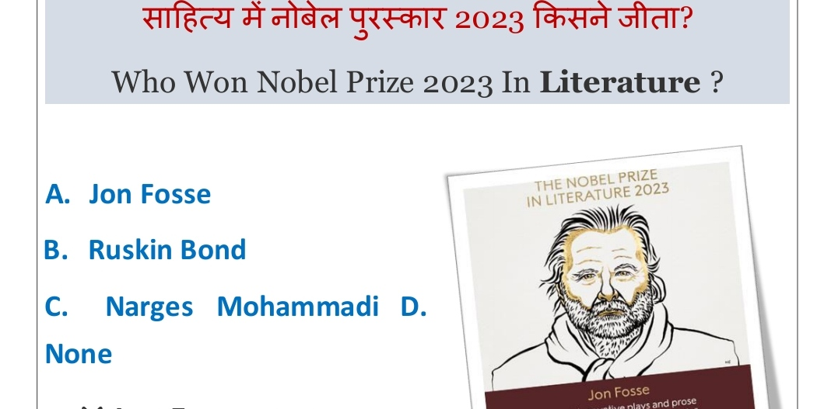

Slide 53
A- Jon Fosse

Slide 54
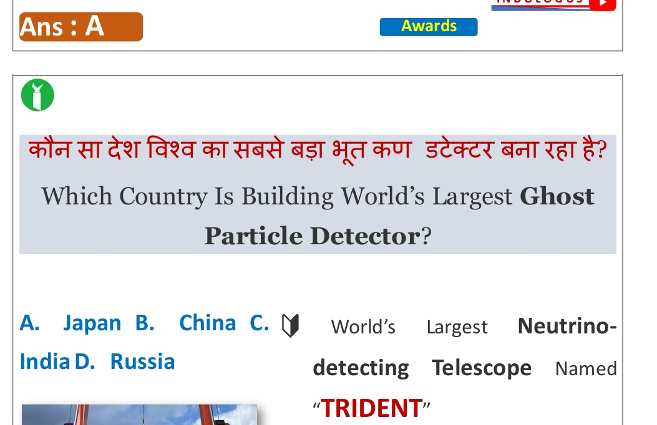

Slide 55
China

Slide 56
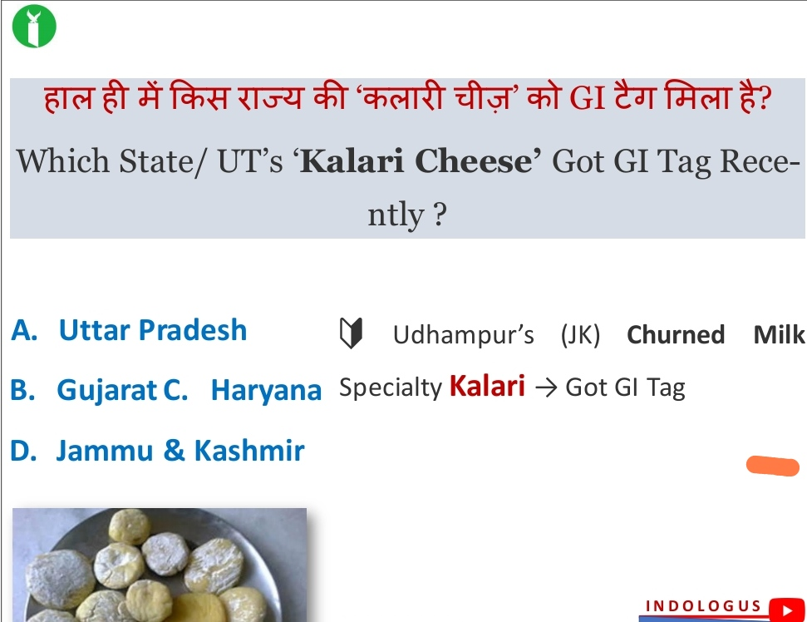

Slide 57
Jammu and Kashmir

Slide 58
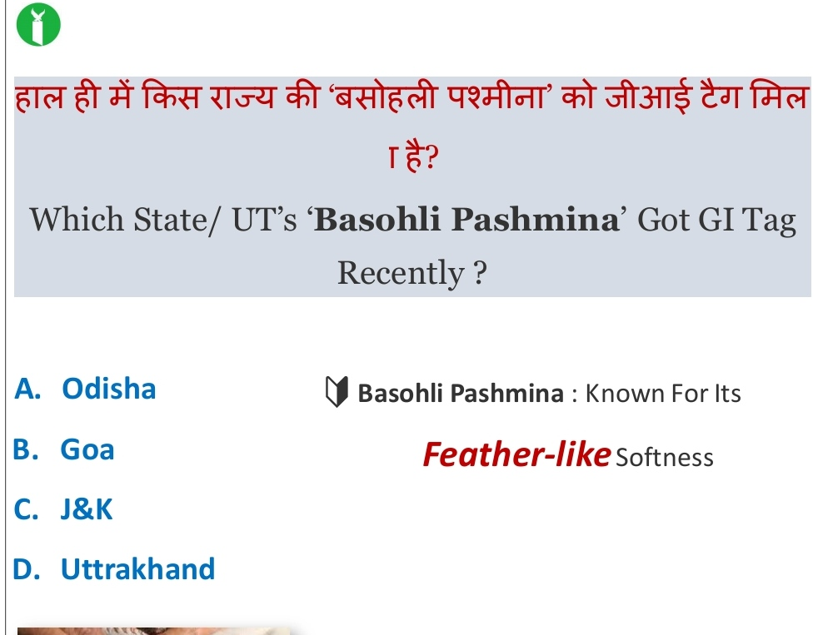

Slide 59
Jammu and Kashmir

Slide 60
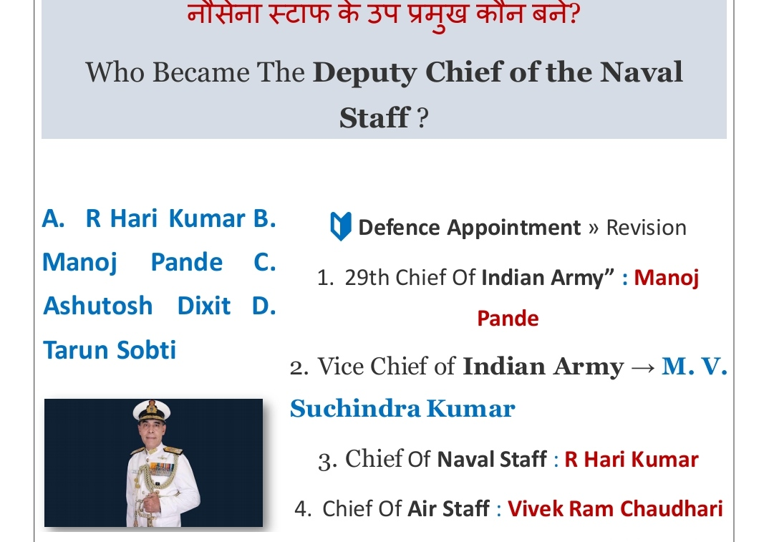

Slide 61
Ashutosh Dixit

Slide 62
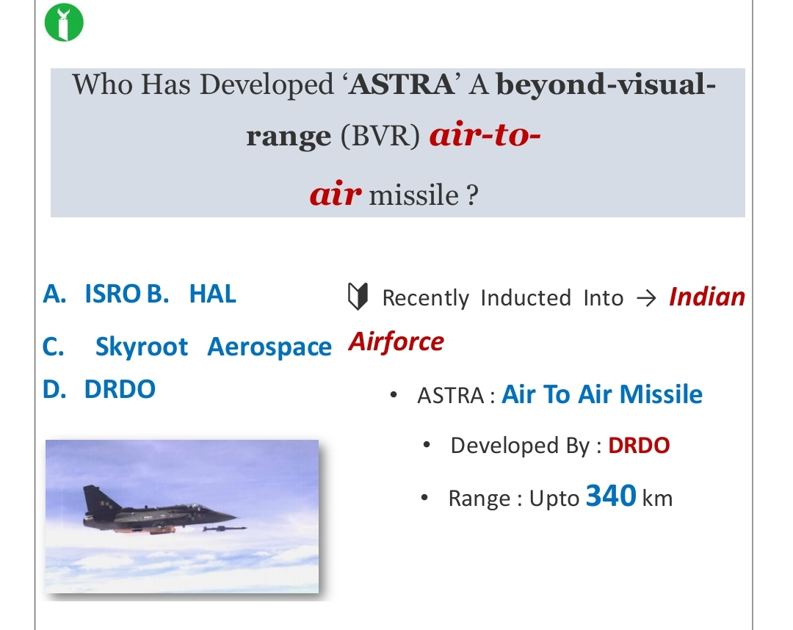

Slide 63
DRDO

Slide 64
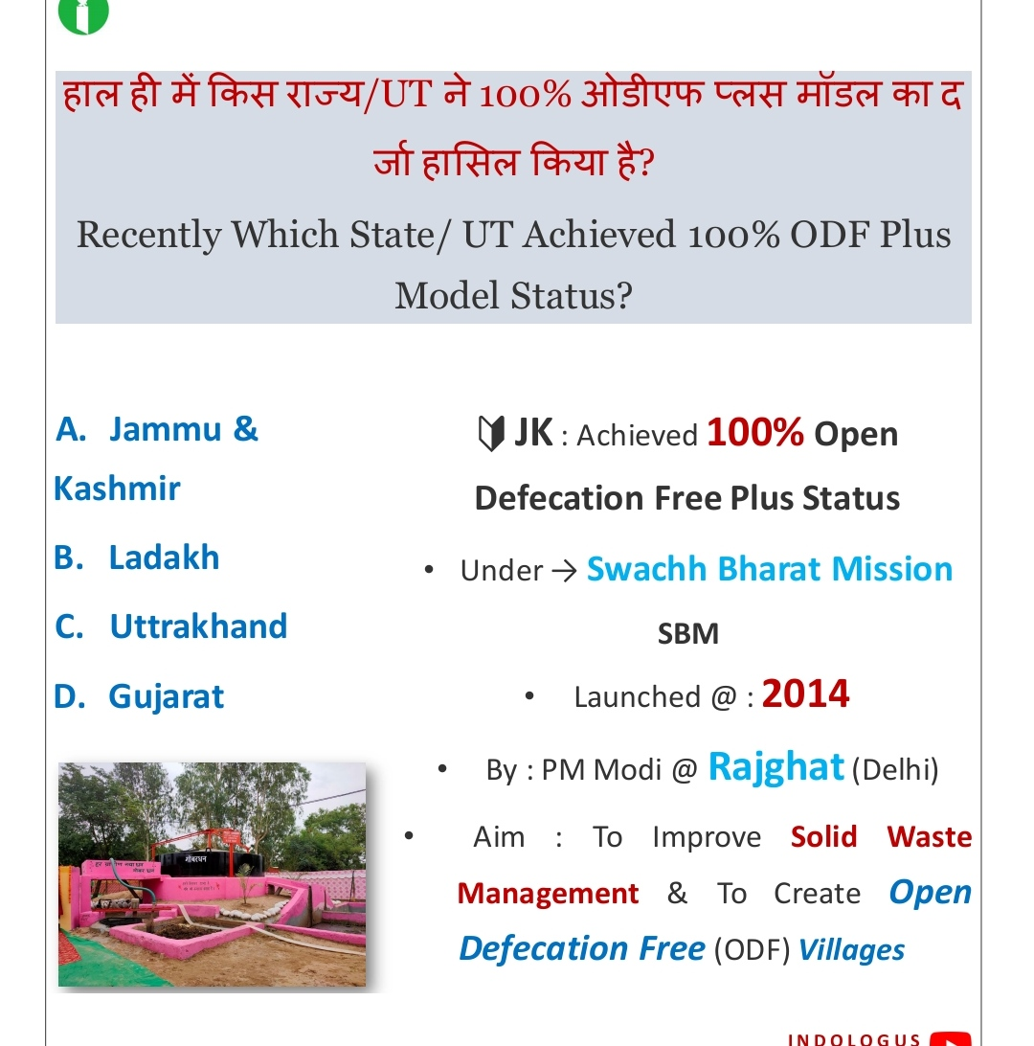
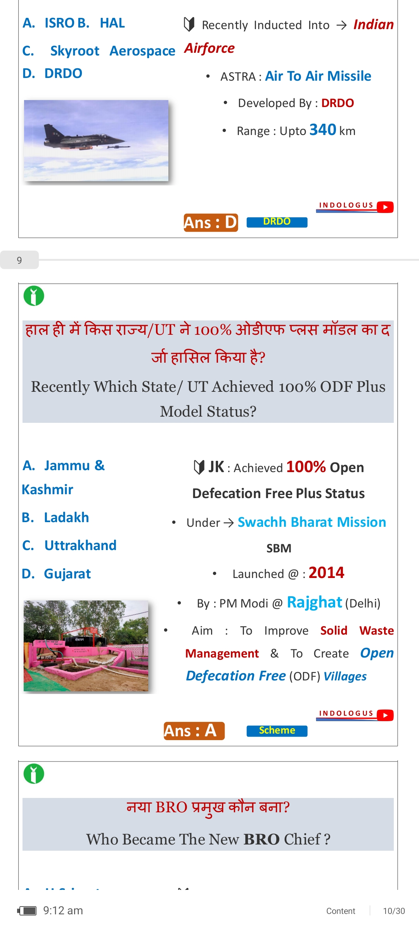

Slide 65
Jammu and Kashmir

Slide 66
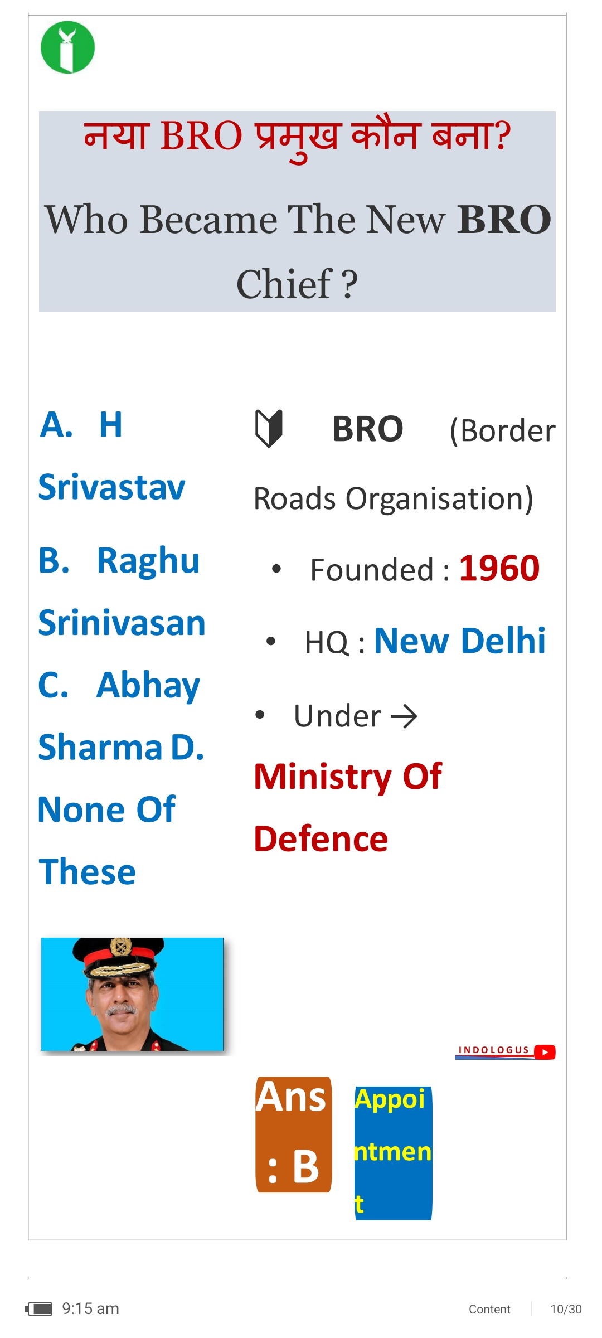

Slide 67
Raghu Srinivasa

Slide 68

Name the flag

Slide 69
Saint Lucia

Slide 70

Name the continent this flag belongs?

Slide 71
Asia

Slide 72
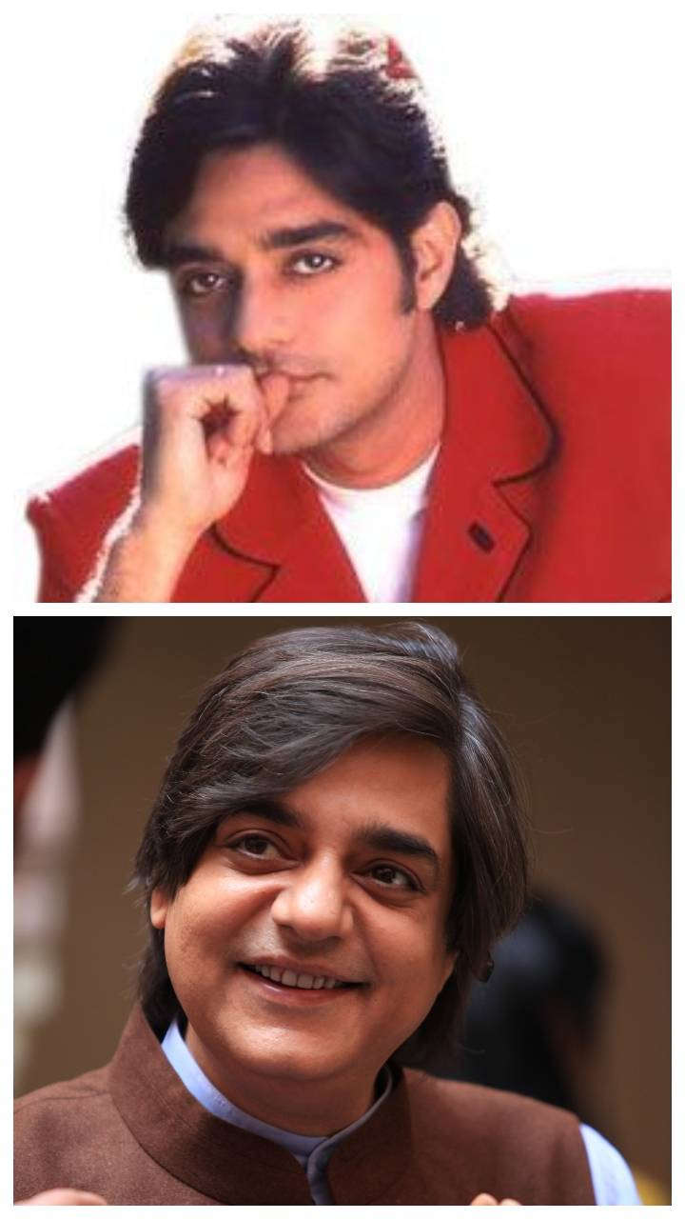
Name the Actor ? अभिनेता का नाम बताएं?

Slide 73
चंद्रचूर सिंह

Slide 74
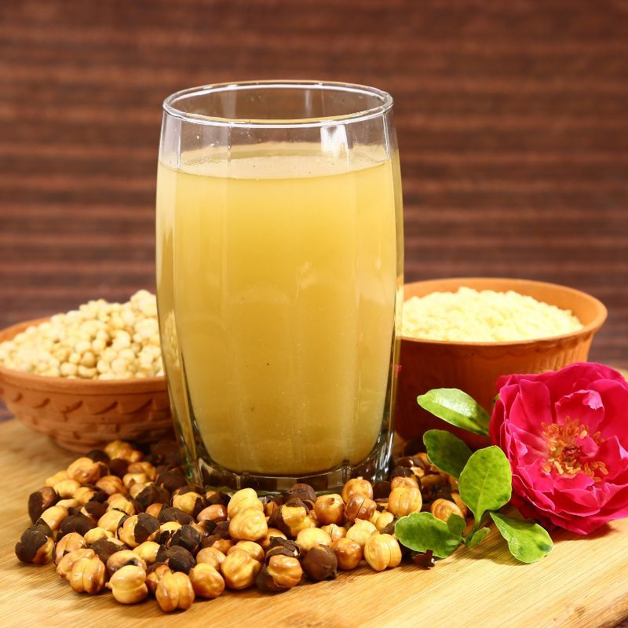
What is the name of the drink

Slide 75
Sattu ( Hindi)
सत्तू (Provisional Bihar , Bharat) , छातू
(Bengali), सतुवा ( Nepali , Bihari )

Slide 76
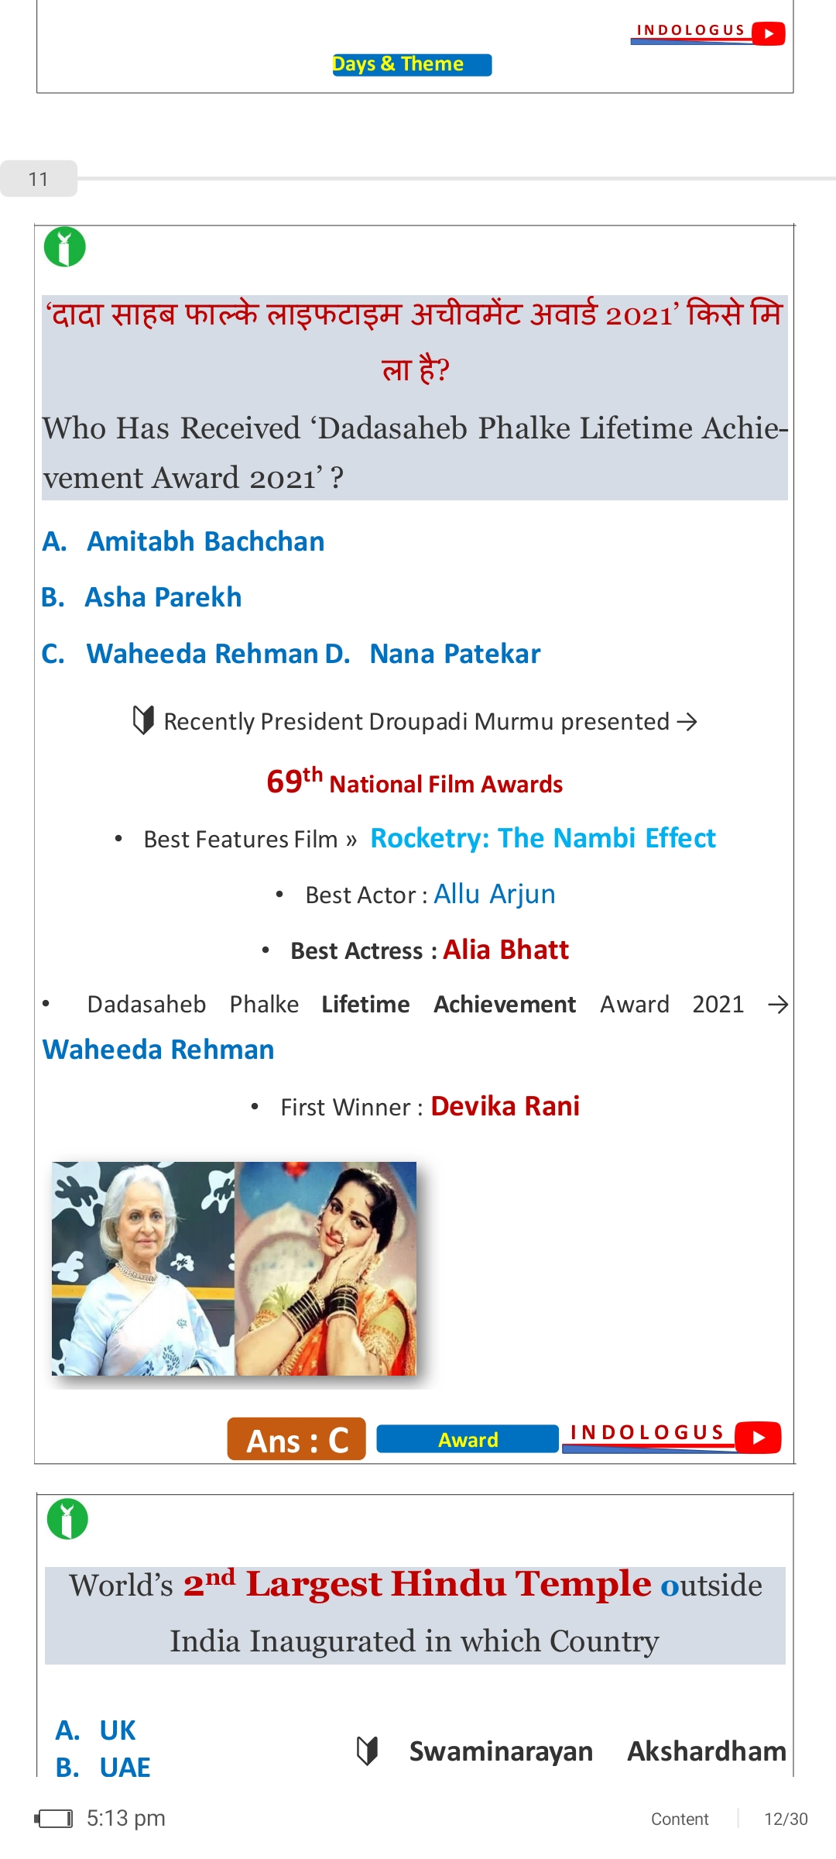

Slide 77
Waheed RD

Slide 78
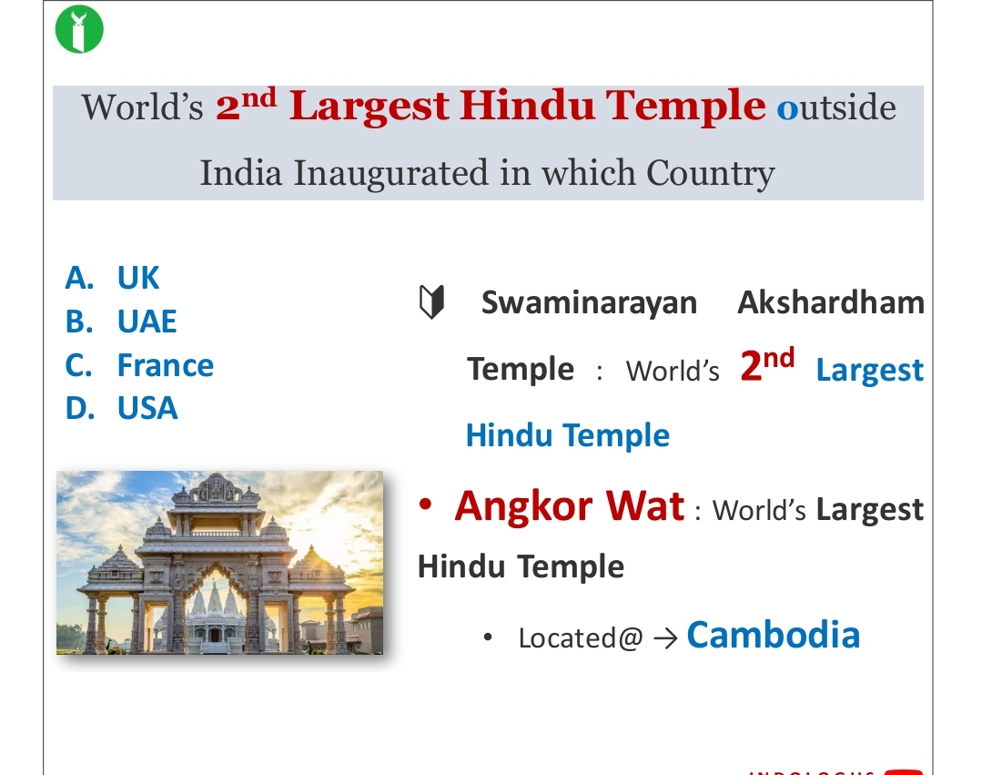

Slide 79
USA

Slide 80
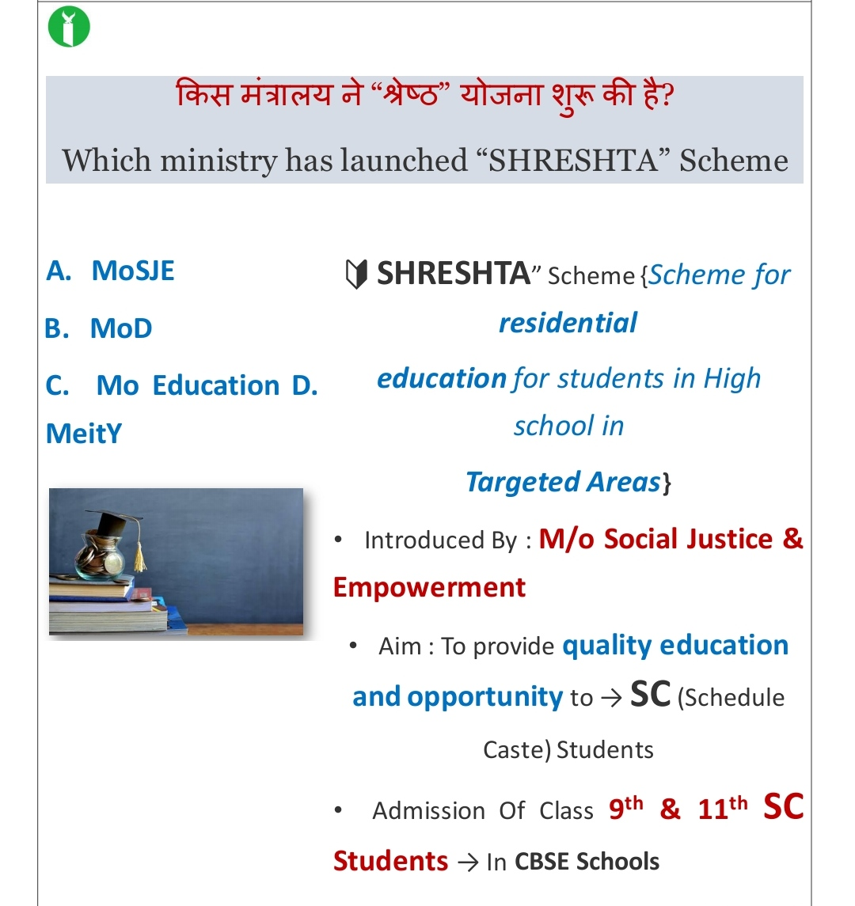

Slide 81
MoSJE

Slide 82
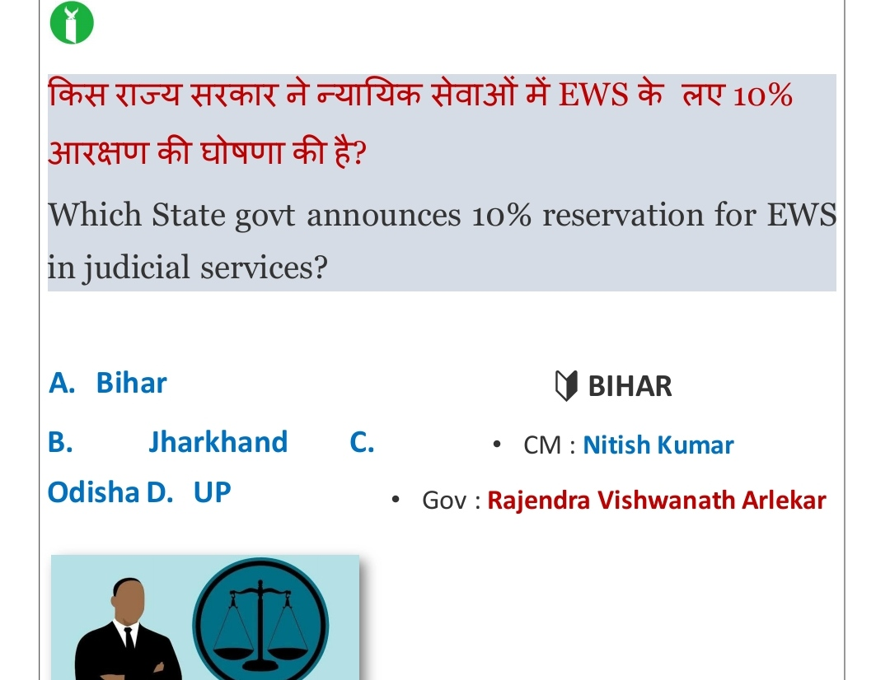
Gsghehshhshshhshshshhshshshdhdhdhhdhdhdhdhhdhdhdhbdbdbdhhdbdbdbbdhdhjdjdjdj

Slide 83
Bihar

Slide 84
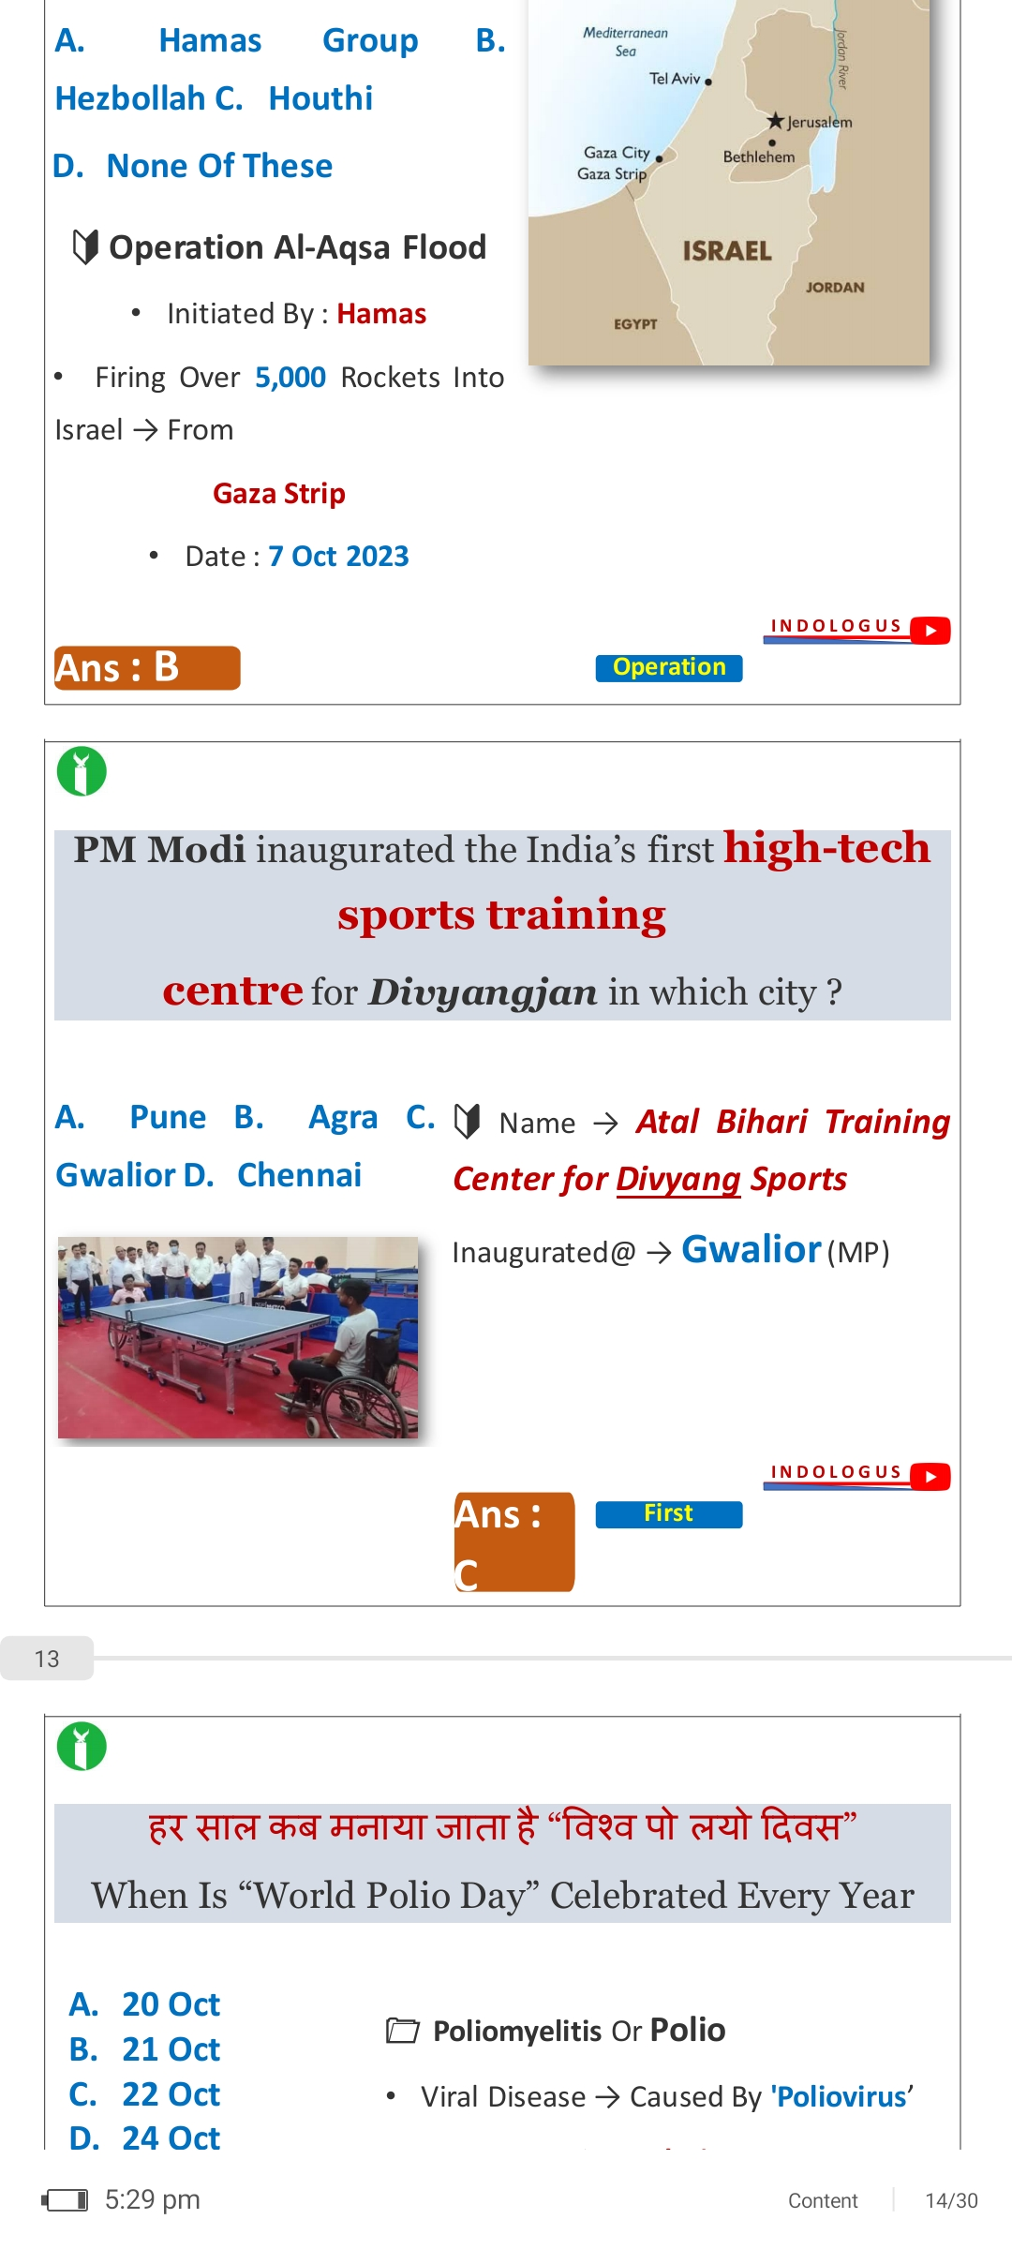

Slide 85
Gwalior

Slide 86
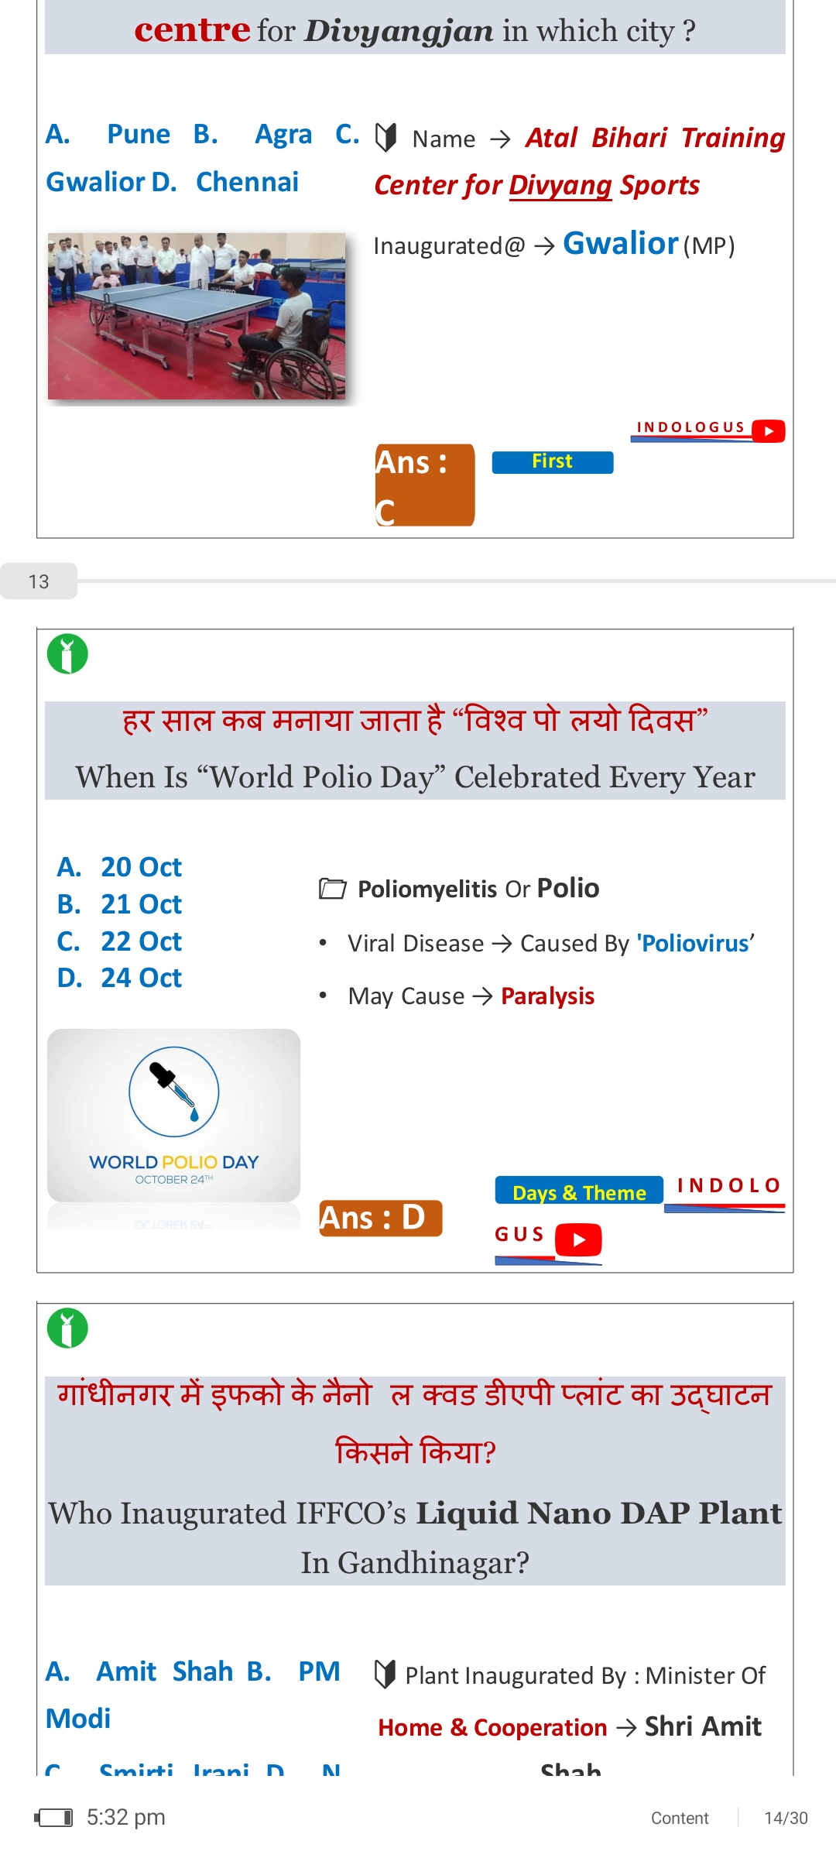

Slide 87
22nd October

Slide 88
Which Rocket Has Been Used to Launch 'Aditya-L1’ Mission

Slide 89
PSLV C-57

Slide 90
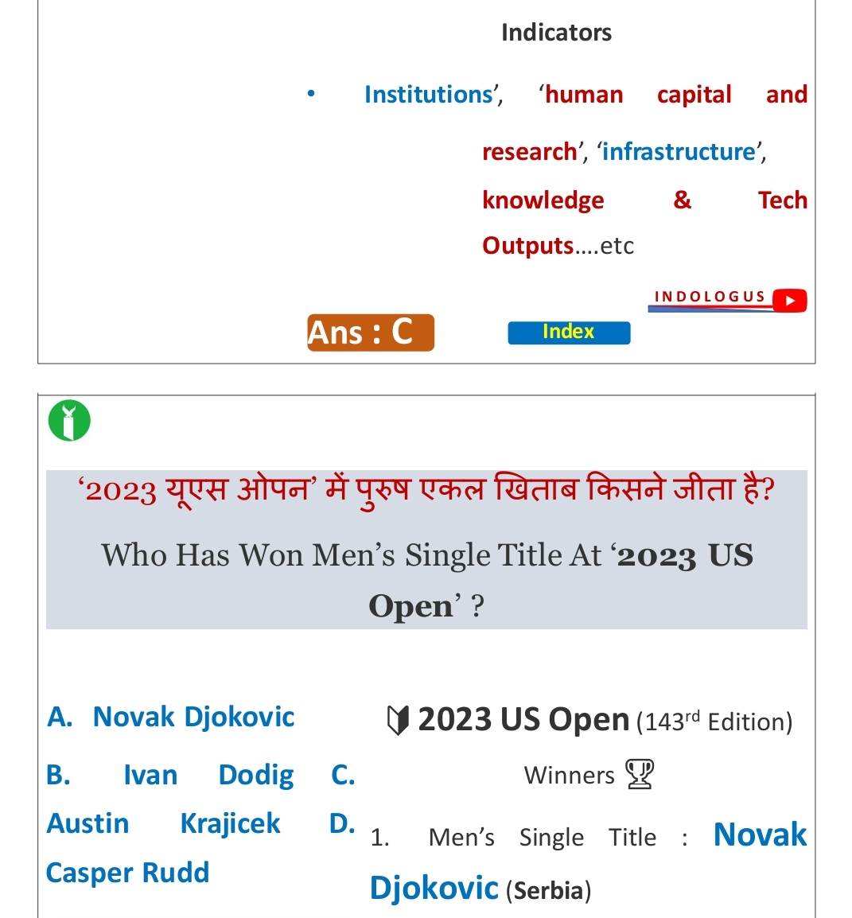

Slide 91
Novac Djokovic

Slide 92
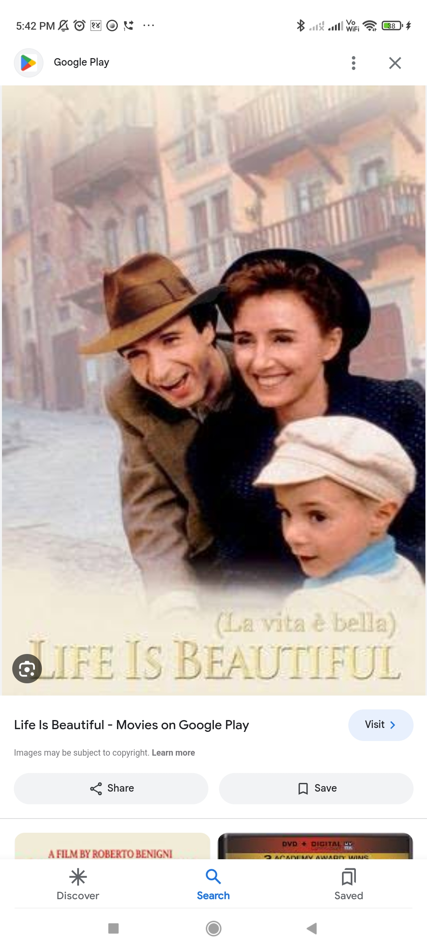

Slide 93
Name the movie

Slide 94
Life is Beautiful

Slide 95
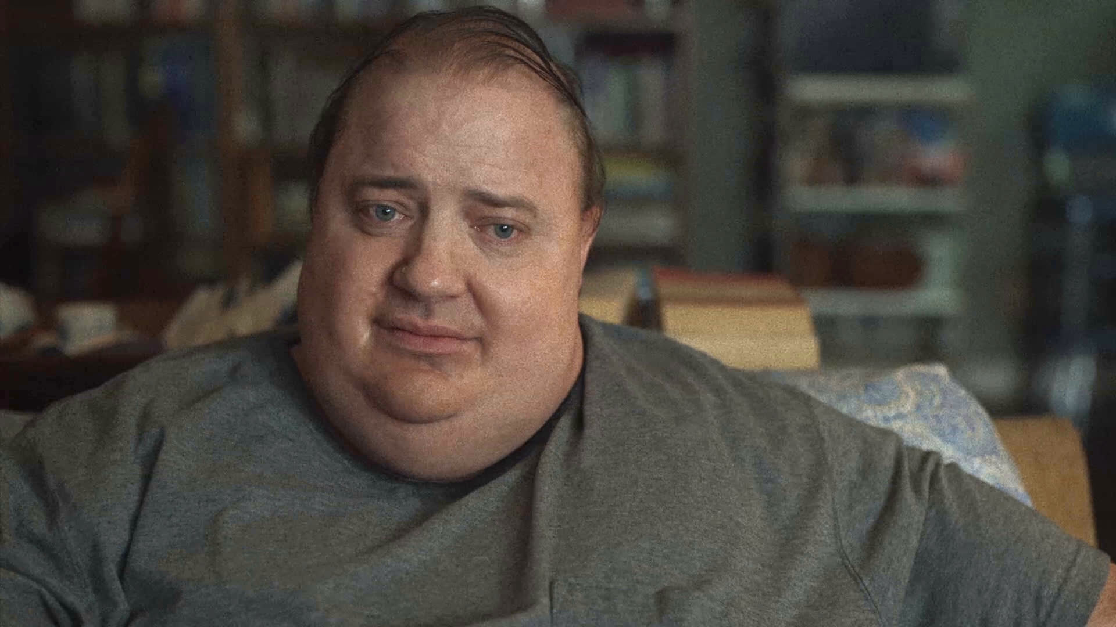
Name the Actor ? इनका नाम बताएं?

Slide 96
Brednan fraser

Slide 97
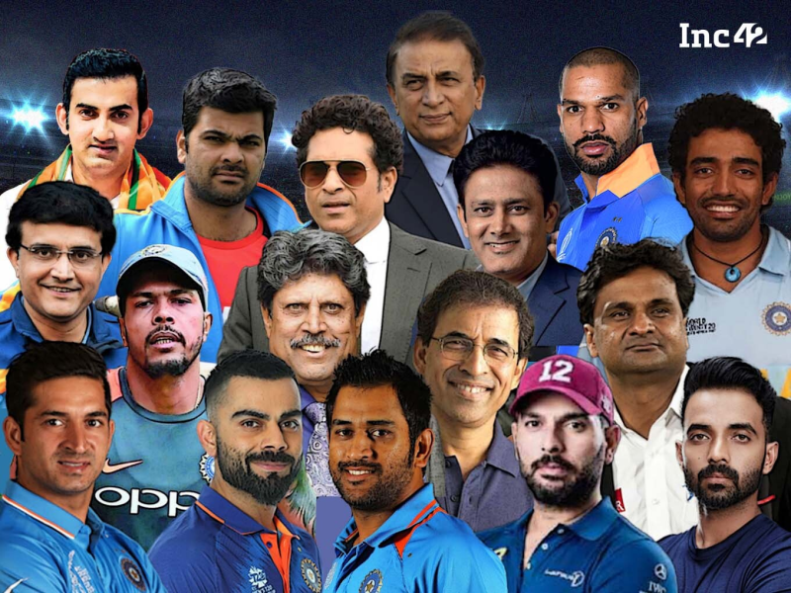

Slide 98
Name the Man with the 12 number cap ? कैप लगाने वाले इंसान का नाम बताएं?

Slide 99
युवराज सिंह

Slide 100
उन्होंने किस बॉलर को 6 चक्के मारे थे?

Slide 101
Stuart Broad

Slide 102
Speed and velocity what is the difference?
भिन्नता बताएं speed और velocity में?

Slide 103
Speed - Scalar
Velocity - Vector

Slide 104
Which is radioactive
Helium
Polonium
Carbon
Bromine

Slide 105
Polonium

Slide 106
Super 30
In this film which exam is they concerned about ?
सुपर ३० फिल्म में कोनसा एग्जाम के बारे में जिक्र हैं ?

Slide 107
JEE

Slide 108
NEET exam का फुल फॉर्म बताएं?

Slide 109
National eligibility cum entrance Test

Slide 110
What is the full form of NCERT

Slide 111
National Council of Educational Research and Training

